Slide 1
Improving Patient Cohort Identification by Retrieving Social Determinants of Health Components from Clinical Notes
Stephen Shaffran, Sws59
Harikesh Subramanian, Has201
Chenyu Li, Chl367
Notes:
Hello
This is Stephen, HArikesh , Chenyu and today for our project for Infsci 2140 : Titled Improving patient cohort identifiaction by retrieving Sdoh components from Clinical notes

Slide 2
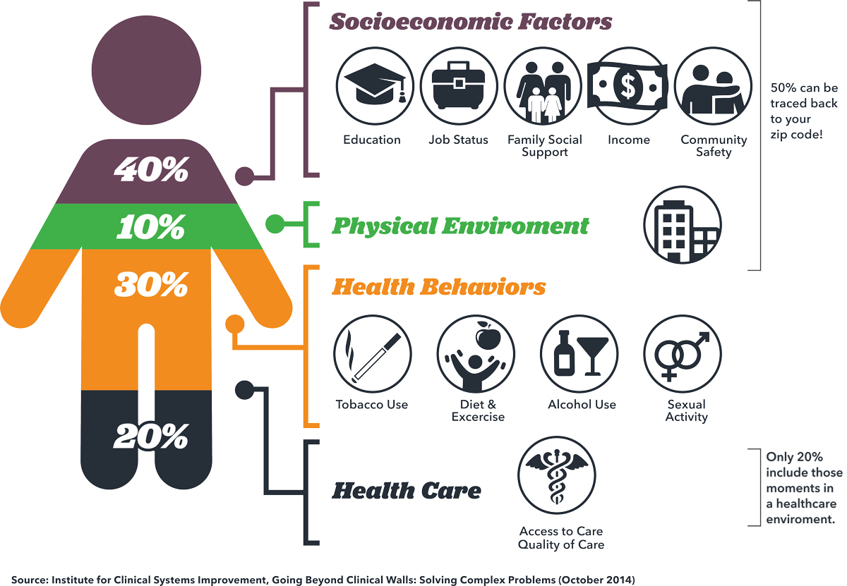


Background
Notes:
According to research, only 20 percent of a person's health outcomes may be attributed to events that occur at the clinician's office.(1) The remainder is determined by individual behavior and the settings and circumstances of people's living environments These variables are referred to as social determinants of health (SDOH). The social determinants of health refer to the social and economic factors that can influence an individual's overall health. These factors can include things like access to education, job opportunities, income, and living conditions. In observational research, the social determinants of health are studied to understand how they impact the health outcomes of individuals or populations. Do research on SDoH can help researchers identify potential interventions or policies that could improve health outcomes and reduce health disparities.
Cohort identification is an important step in observational research because it allows researchers to identify a group of individuals who share certain characteristics or experiences, and then study how those characteristics or experiences impact their health outcomes. This is important because it allows researchers to isolate specific factors that may be contributing to health outcomes, and to better understand the relationships between different variables. By identifying and studying well-defined patient cohorts, researchers can gain valuable insights that can be used to develop more effective interventions and treatments.
A reliable collection of SDoH data at the point of care can help clinicians provide personalized recommendations to their patients. By understanding the SDoH of their patients, clinicians can tailor their recommendations to address the specific social and economic factors that may be impacting an individual's health. For example, a clinician might recommend a low-cost exercise program to a patient who lives in a low-income neighborhood, or refer a patient to a financial assistance program if they are having trouble paying for their medications.

Slide 3
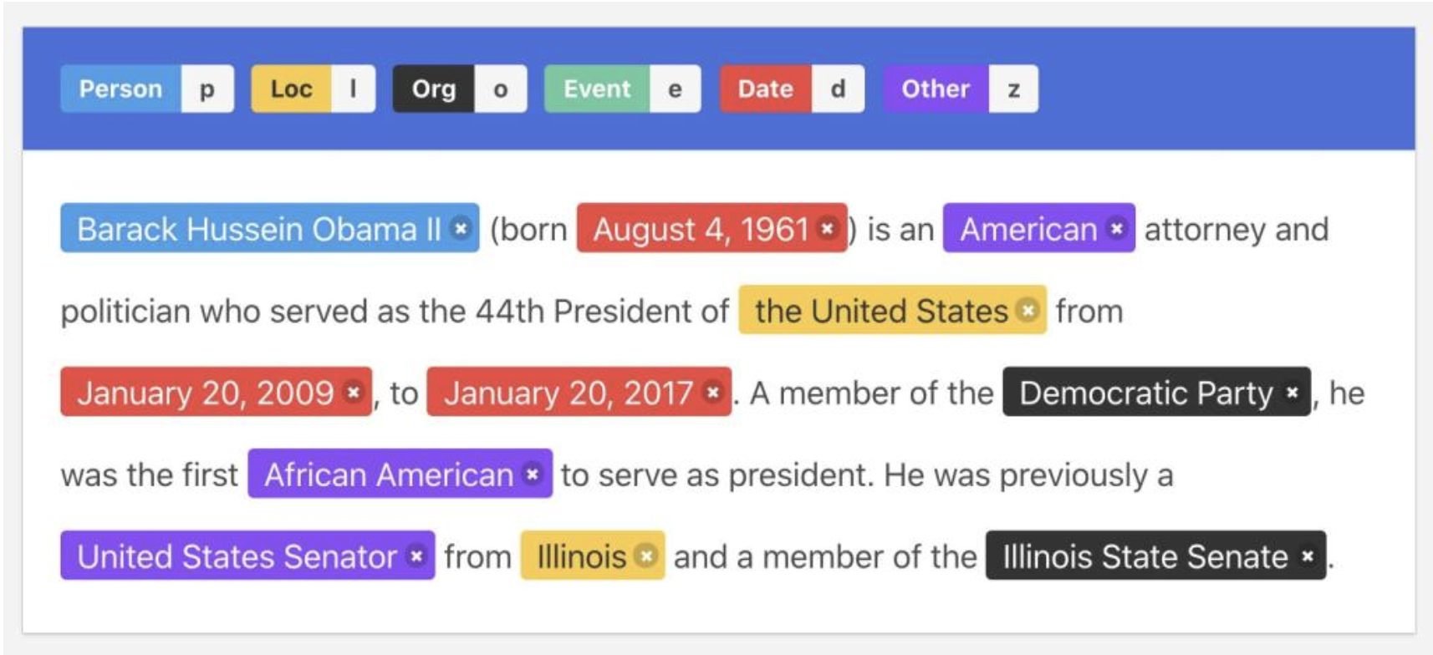
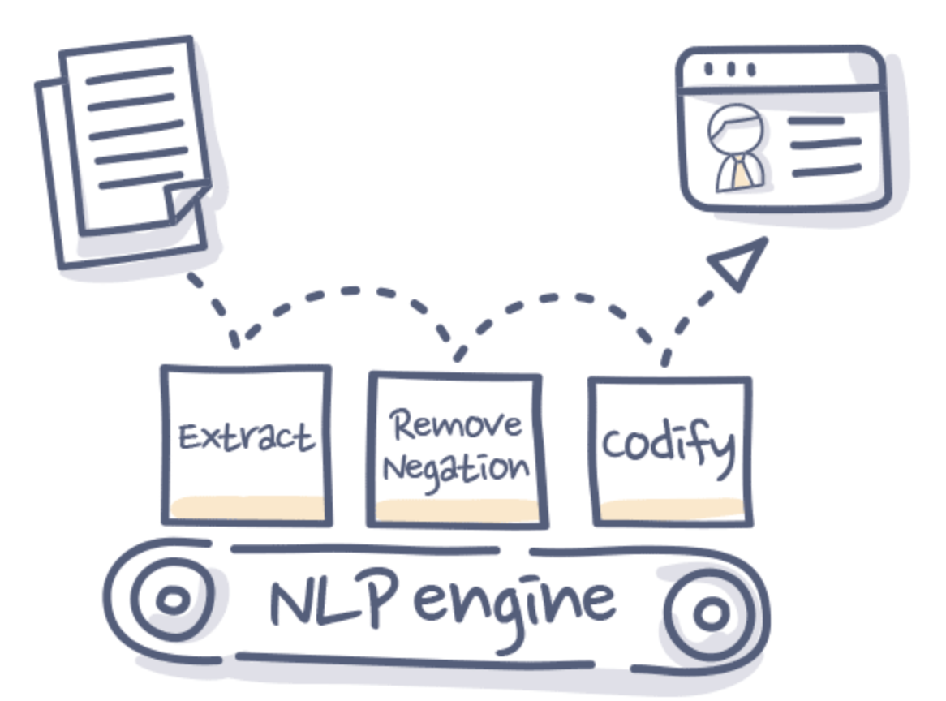
Problem statement
Notes:
Social determinants of health (SDoH) data that is collected in electronic health records (EHRs) is often unstructured. This means that the data is not organized in a consistent or standardized format, making it difficult to analyze and interpret.
SDoH data in EHRs can take many different forms. It may be recorded as free-text notes in a clinical note, as coded data in structured fields, or as unstructured data in other parts of the EHR. This can make it challenging to identify and extract SDoH data from EHRs, as there may be no consistent way to locate the relevant information. An in current cohort identification tools, SDoH data is alway missing, there is a gap to extract SDoH from unstructured EHR data for further observations research analyses.
To overcome this challenge, researchers can use Information Retrieval and natural language processing (NLP) to extract the unstructured notes in EHRs and identify mentions of SDoH-related data element.
We aim to build a cohort extraction tool that can help identifying patient cohort using both unstructured and structured data. This cohort identification tool will be able to search relevant SDoH data component that is not in a structured format, and return the relevant patient structured information. Information retrieval techniques could help us achieve this goal.

Slide 4



Potential Users
Researchers who wish to extract cohorts of specific patients for a preliminary exploratory analysis
Electronic health systems that wish to implement a search module in the live EHR during clinical care
Insurance companies for identifying an observational cohort for analysis on costs and payments
Notes:
The potential users will include, 1. Researchers who want to extract cohorts of specific patients for a chart review or observational research.
2. Electronic health systems that could implement such search models in the live ERH during the clinical care.
3. Insurance companies which do observations research on analyzing how SDoH related to costs and payments.

Slide 5





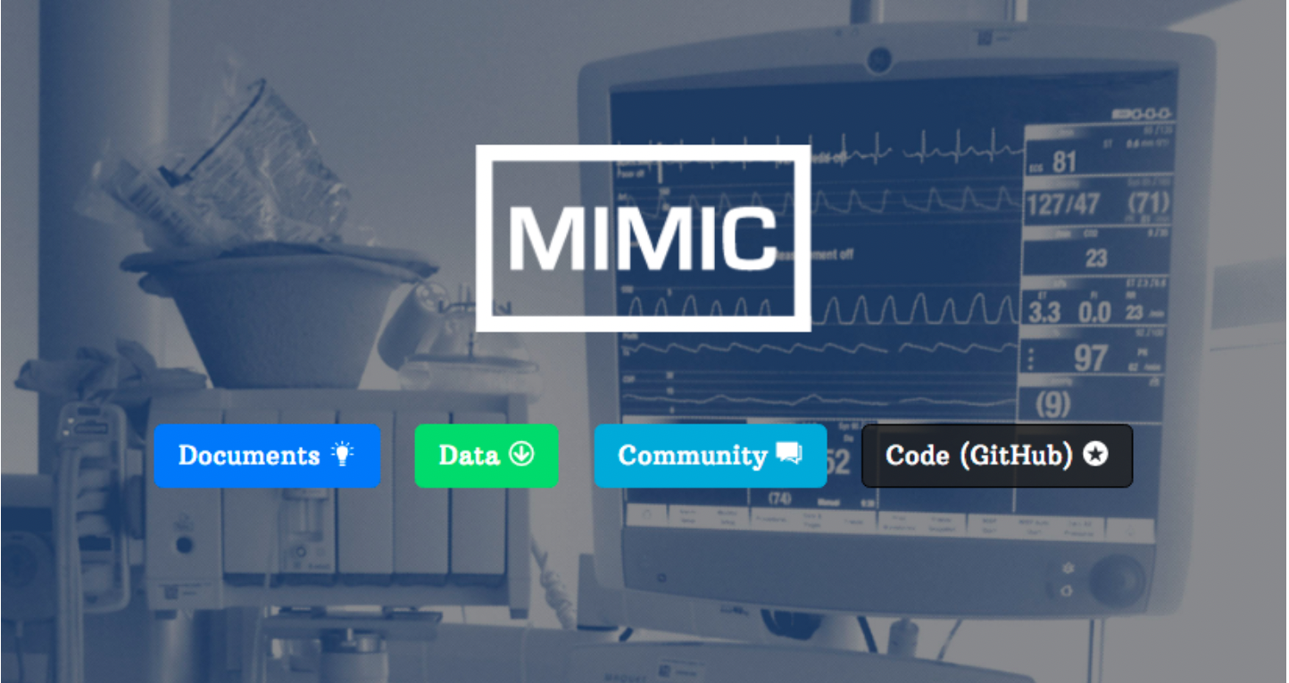
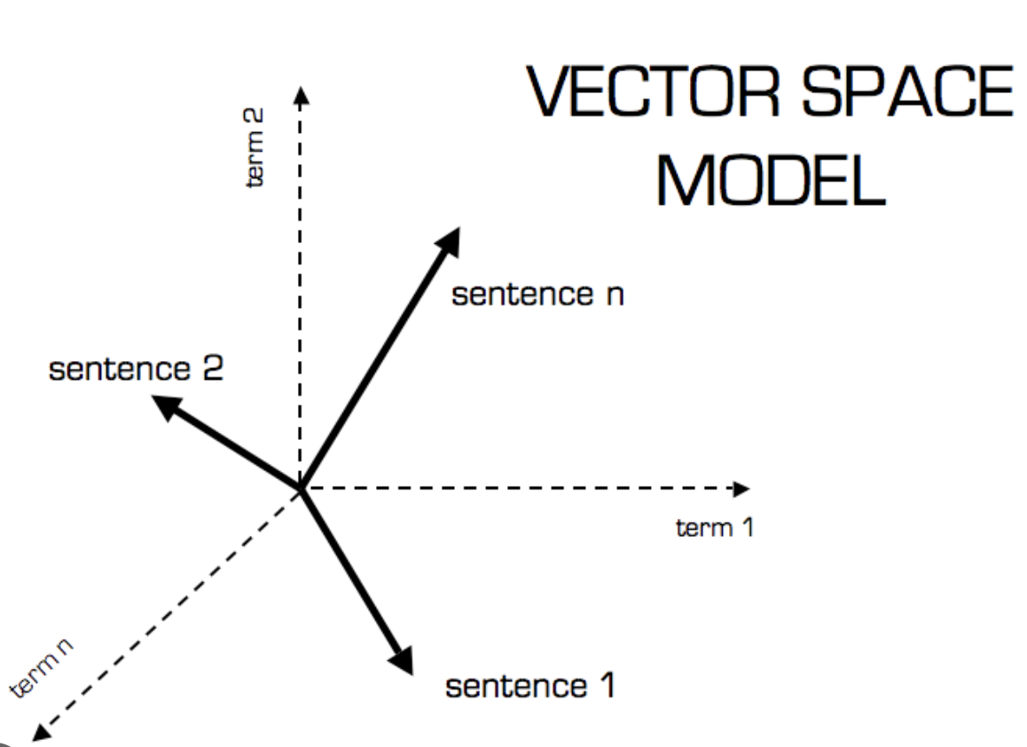
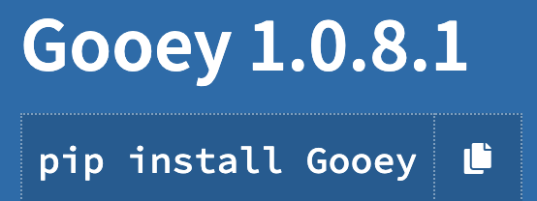
Solution and Resource Building Information Retrieval Indexing and searching system
MIMIC-III
Discharge Notes
Indexing and Ranking
Structured data
Front End

Slide 6

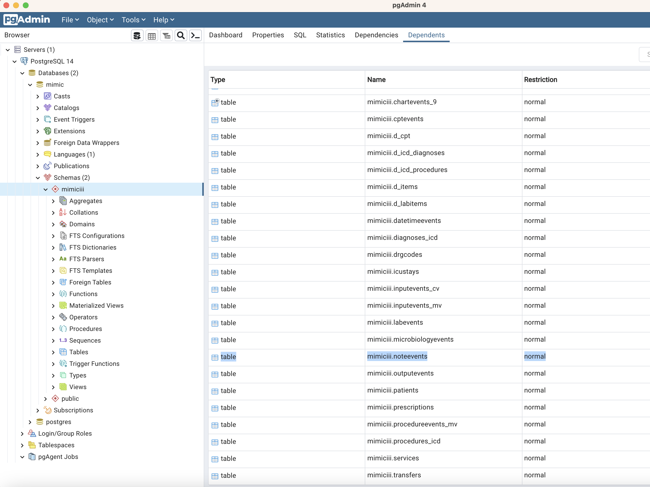
Major Steps
Build local database
Create corpus AND tf-idf for all discharge notes
Build retrieval tool
Evaluate the tool with SDoH keywords
Final report - presentation

Slide 7
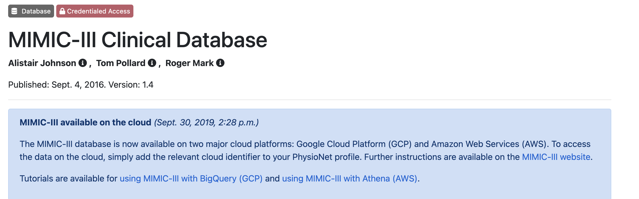
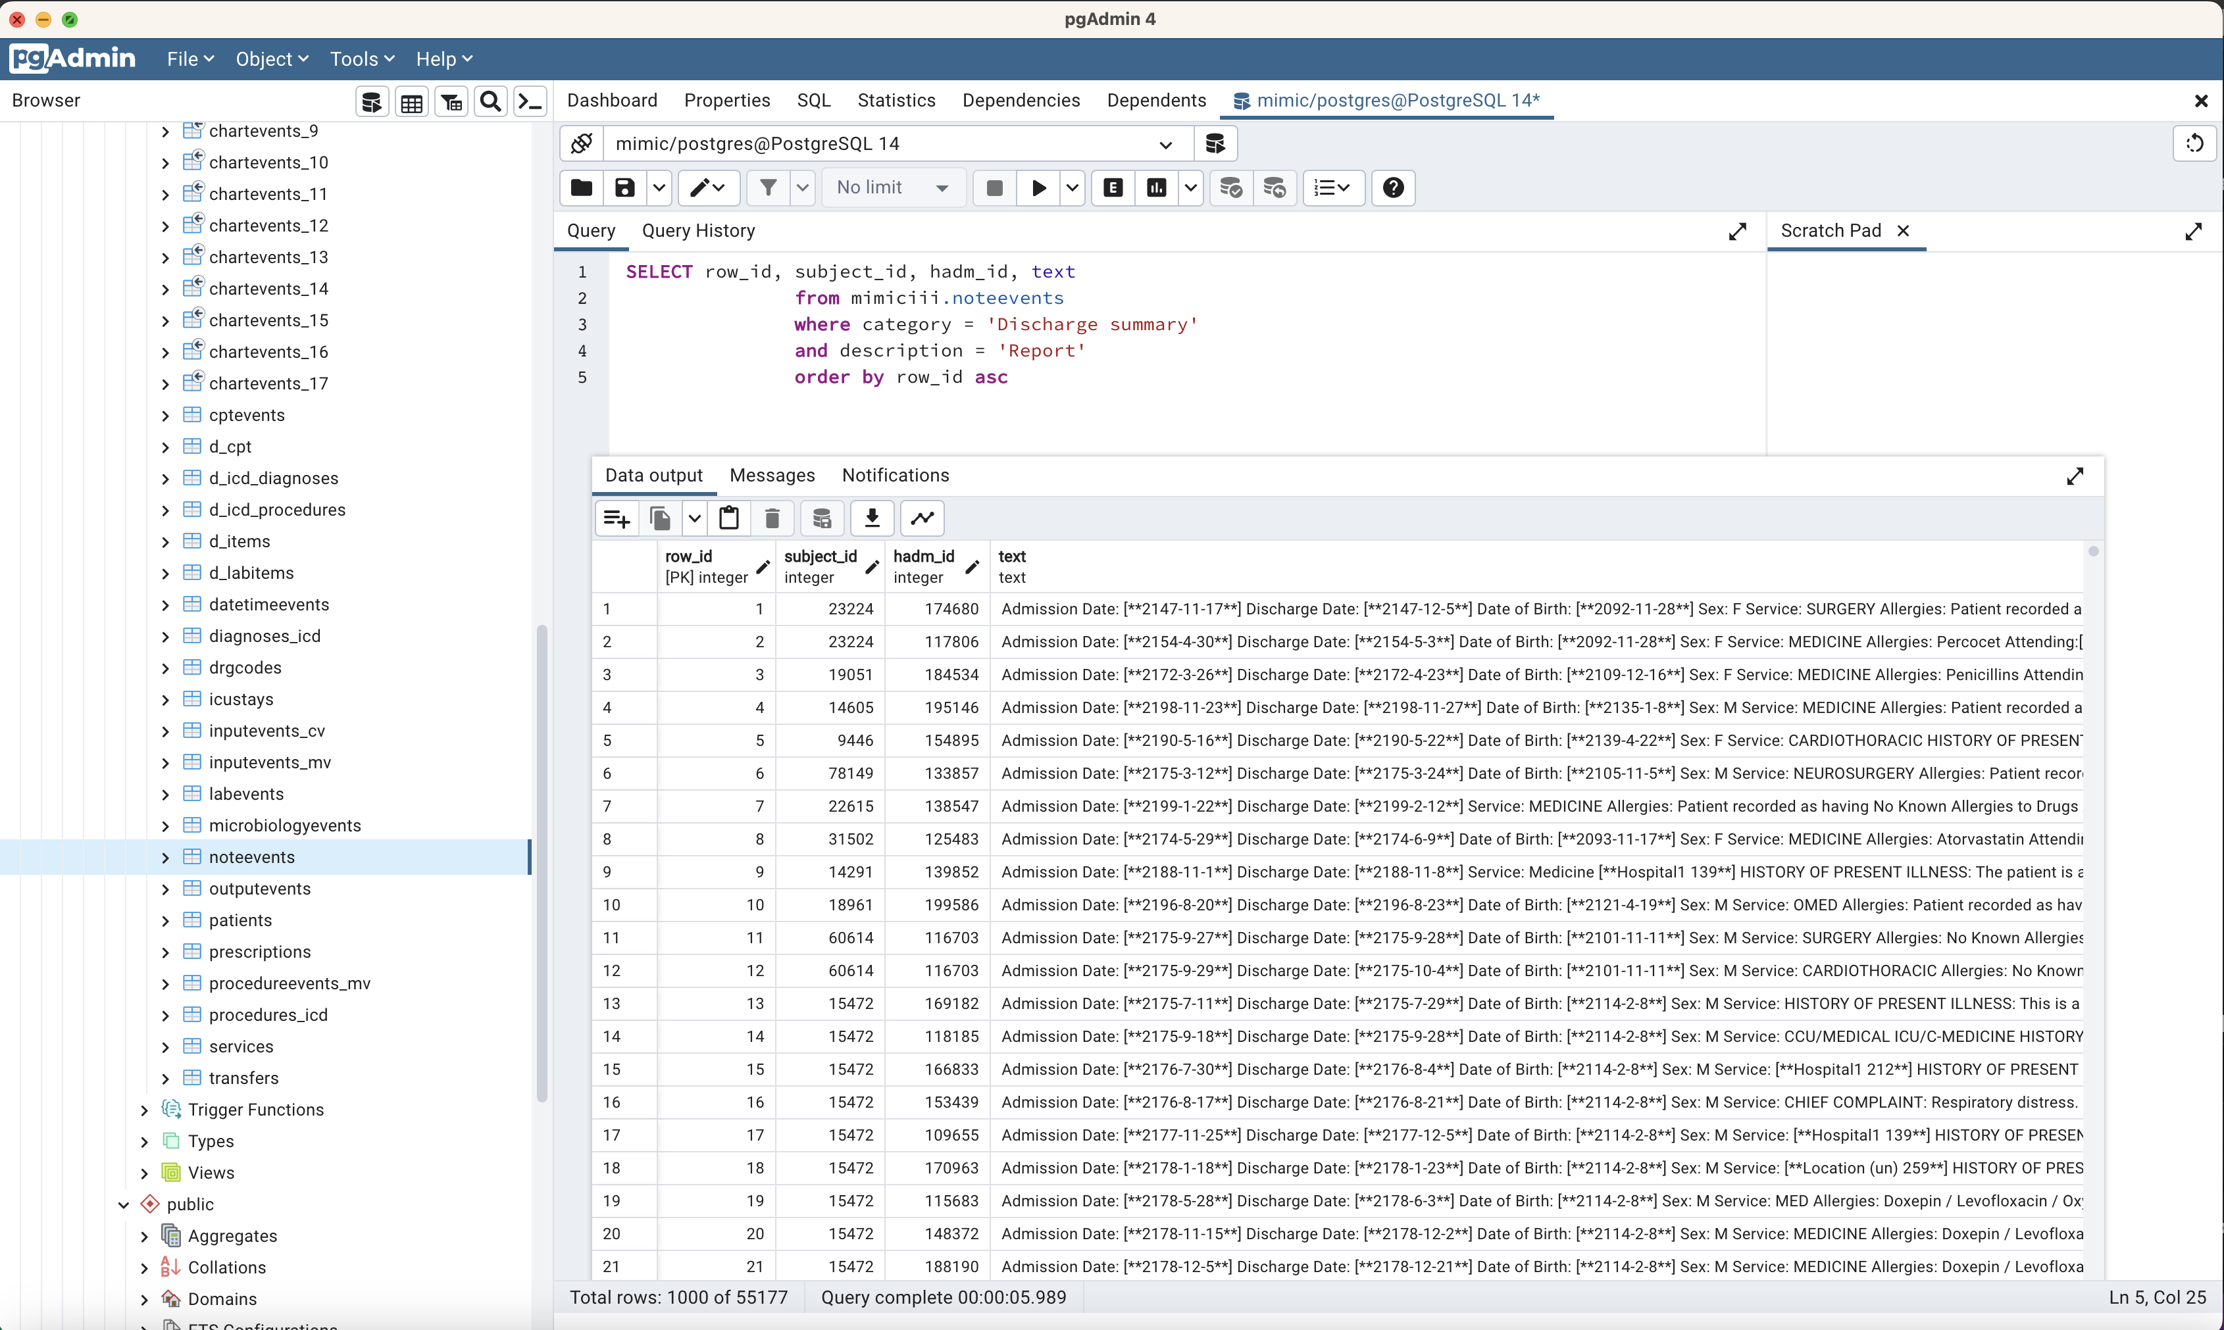
MIMIC III database
Large deidentified health-related data
40,000 patients
Information included in both structured and unstructured format
Demographics, vital sign measurements, laboratory test results, procedures, medications, caregiver notes, imaging reports, and mortality and clinical notes.
55177 in total “Discharge summary” “report”

Slide 8
Create corpus AND tf-idf for all discharge notes
Extracted the Discharge summaries from MIMIC –noteevents table
Stemmer : NLTK snowballstemmer
Numbers were removed
Case folding
Created a Corpus
Calculated tf-idf

Slide 9
Workflow
Corpus
Stored data
Doc-Term Matrix
Vector-Space Model
Query Input
Retrieval Tool
Output Cohort
User
Filters
MIMIC-database
Front end
Output text

Slide 10
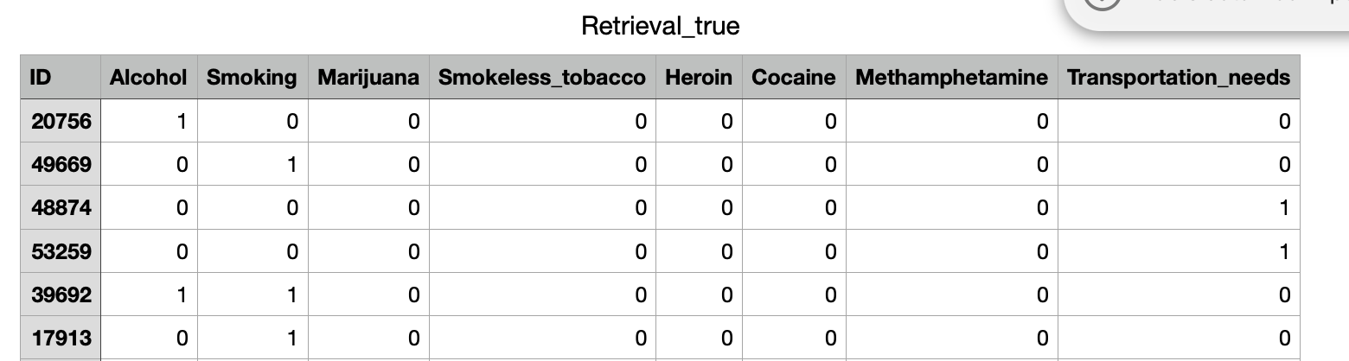
Tool Evaluation
Randomly selected 100 documents
Annotated manually on 8 search queries.

Slide 11
Performance
Alcohol: relevant docs: 21, R-precision: 10/21 (0.48)
Smoking: relevant docs: 29, R-precision: 16/29 (0.55)
Marijuana: relevant docs: 1, document was not returned
Smokeless Tobacco: relevant docs: 1, returned at rank 16
Heroin: relevant docs: 2, R-precision: 2/2 (1.0)
Cocaine: relevant docs: 3, R-precision: 2/3 (0.67) (third at rank 4)
Methamphetamine: relevant docs: 0, one document returned
Transportation needs: relevant docs: 4, R-precision: 0/4 (0.0)

Slide 12
Team collaboration
Chenyu -> MIMIC data preprocessing, build corpus, indexing
Stephen -> Retrieval tools
Hari -> UI, annotations
All of us contribute on preparing presentation.
Good team work!

Slide 13

Thank You!

